Slide 1
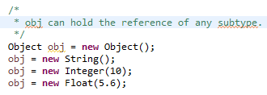
Polymorphism
In Object-oriented programming, polymorphism is the ability to create a variable, a function, or an object that has more than one form.
polymorphism is the ability by which, we can create functions or reference variables which behaves differently in different programmatic context.
An example of polymorphism is referring the instance of subclass, with reference variable of super-class.
String,Integer,Float are subclasses of Object class

Slide 2
Polymorphism
Polymorphism
Compile time polymorphism
(static binding or method overloading)
Runtime polymorphism
(dynamic binding or method overriding)

Slide 3
Polymorphism
Compile time polymorphism (static binding or method overloading)
As the meaning is implicit, this is used to write the program in such a way, that flow of control is decided in compile time itself. It is achieved using method overloading.
In method overloading, an object can have two or more methods with same name, BUT, with their method parameters different. These parameters may be different on two bases:
1) Parameter type:
2) Parameter count

Slide 4
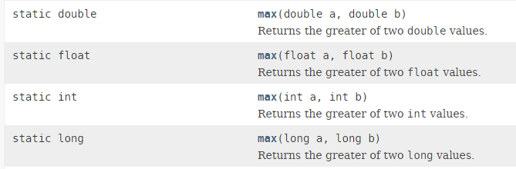
Polymorphism
Parameter type: Type of method parameters can be different. e.g. java.util.Math.max() function comes with following versions:
The actual method to be called is decided on compile time based on parameters passed to function in program.

Slide 5
Polymorphism
Parameter count: Functions accepting different number of parameters. e.g. in employee management application, a factory can have these methods:
Both methods have same name “create” but actual method invoked will be based on parameters passed in program.
EmployeeFactory
public void create(String firstName, String lastName)
{
...
}
public void create(Integer id, String firstName, String lastName)
{
...
}

Slide 6
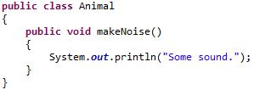



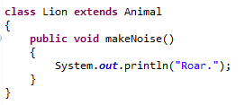
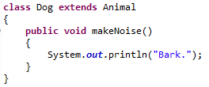
Polymorphism
Runtime polymorphism is essentially referred as method overriding. Method overriding is a feature which you get when you implement inheritance in your program.
A simple example can be from real world e.g. Animal. An application can have Animal class, and its specialized sub classes like Cat and Dog. These subclasses will override the default behavior provided by Animal class + some of its own specific behavior.
Now which makeNoise() method will be called, depends on type of actual instance created on runtime.
extends
extends

